Slide 1
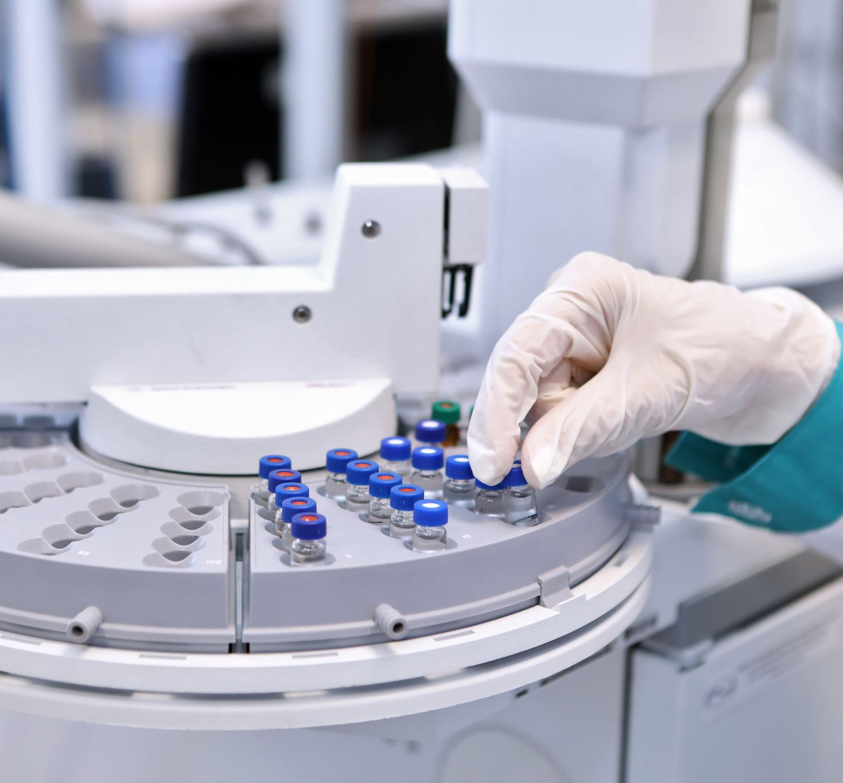
CSCI 4050 – Machine Learning Final Project (Diabetes and Insulin Prediction)
By: Li Chen (100813628) and

Slide 2
Table of Contents
Project Overview
Architecture and Tech Stack
Section 1: Diabetes Prediction
Data Processing
Model and Training
Deployment
Section 2: Insulin Prediction
Data Processing
Model and Training
Deployment
Lessons Learned
Conclusion/Future Work

Slide 3
Project Overview
Learning Problems
Motivation

Slide 4
Architecture and Technology Stack

Slide 5
Section 1: Diabetes Prediction
(Data Processing)

Slide 6
Section 1: Diabetes Prediction
(Model and Training)

Slide 7
Section 1: Diabetes Prediction
(Deployment)

Slide 8
Section 2: Insulin Prediction
(Data Processing)

Slide 9
Section 2: Insulin Prediction
(Model and Training)

Slide 10
Section 2: Insulin Prediction
(Deployment)

Slide 11
Lessons Learned

Slide 12
Conclusion/Future Work

